Slide 1
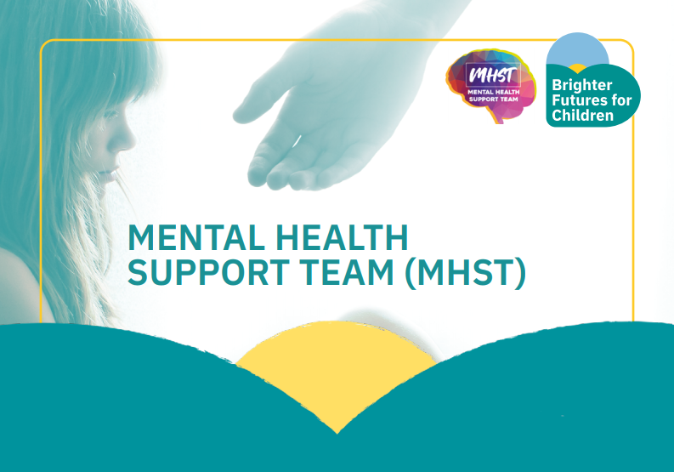

Emotional Wellbeing Helpline: 07702 339000
Our Aim
How we Work
We provide early interventions to support children & families who fall under the radar, as their difficulties would not meet the threshold for Children and Adolescence Mental Health Services (CAMHS).
We help families and young people with mild to moderate anxiety and help parents to deal with challenging behaviour.
We work with parents and carers to skill you up to be able to manage and support with worries and challenging behaviour your children may have. We value you as the experts; you know your child best, and we want to help you by discussing behavioural management strategies and ways to manage common worries.
How to get a Referral
If you’re interested in working with us, please contact a member of the pastoral team at WJGS- Mrs Scott Cree, Ms Sholay or Mrs Ryan-Ashton.
School tel: 0208 684 3532

